Slide 1
Module 3
Temporal Difference (TD) Learning

Slide 2
LO1 : Understand MC method
LO2 : Understand 2 types of RL tasks : prediction and control
LO3 : Understand the advantages of MC over DP methods
LO4: Understand the different types of MC prediction
LO5: Apply MC prediction to train an agent to play the blackjack game
LO6: Understand the different types of MC control
LO7: Apply MC control to train an agent to play the blackjack game

Slide 3
Introduction
TD is a popular model-free method
It combines the advantages of DP and MC methods
A recap of pros and cons of DP and MC methods

Slide 4

Dynamic Programming (DP)
Advantages :
Uses Bellman equation to find the value of a state as
We don’t have to wait till the end of an episode to find the value of a state.
We can estimate the value of a state, just based on the value of the next state – boot strapping
Disadvantages:
DP can be used only when the model dynamics is known

Slide 5
Monte-Carlo (MC)
Advantages :
It is a model free method.
We don’t require the model dynamics to estimate the value and Q functions.
Disadvantages:
To find V(s) or Q(s,a), we need to wait till the end of the episode.
If the episode is too long, it will cost us a lot of time.
MC methods cannot be applied to continuous tasks/non-episodic tasks, without a terminal state.

Slide 6
Temporal Difference (TD) learning
We use boot-strapping, and don’t have to wait till the end of an episode to find V(s) or Q(s,a)
Like MC it is a model-free method.
Two categories of TD learning : TD-prediction and TD-control
TD- prediction :
A policy is given as input and we try to predict the V(s) and Q(s,a) using this policy
Helps the agent to understand how good it is for the agent to be in each state, if it uses the given policy
The agent can estimate the expected return of each state, if it uses the given policy in that state.

Slide 7
TD-control:
We are not given any policy as input, but the goal is to find an optimal policy
We initialize a random policy and we try to find the optimal policy iteratively.
This optimal policy will give the maximum return

Slide 8


TD-Prediction
A policy is given as input and we try to estimate the value function of each state V(s), using the given policy
TD uses bootstrapping like DP, hence we don’t have to wait till the end of an episode to find V(s)
Like MC, it doesn’t require the model dynamics to find V(s) and Q(s,a).
The update rule of TD takes these advantages into account.
In MC method,
Since a single return cannot approximate V(s) perfectly, we take the mean of the return over N episodes,

Slide 9



TD learning uses bootstrapping and doesn’t wait till the end of an episode, to find the value of a state as
It doesn’t use the model dynamics.
In MC, since a single value V(s) cannot approximate the value of a state perfectly, we took the incremental mean
In TD, we use the TD-learning update rule

Slide 10
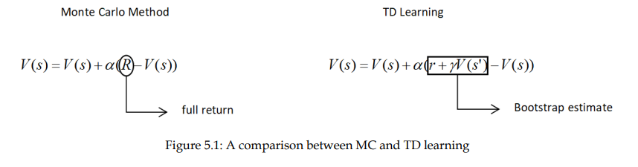
Difference between MC and TD

Slide 11
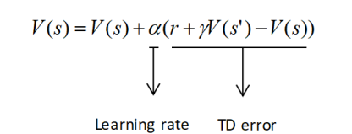
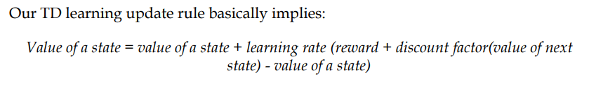

$r+ γV(s^{′})$ is an estimate of the value of a state – called – TD target.
Hence ($r+ γV(s^{′}))$ - V(s) is (target – predicted) – called the TD error.

Slide 12

TD-Prediction using TD-learning
A policy is taken as input, using the update rule of TD-learning, V(s) is updated.
Finally we get the expected return an agent can obtain in each state, if it acts according to the given policy
The update rule of TD-learning is

Slide 13
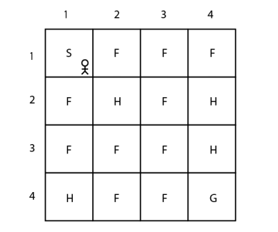
TD-Prediction in FZLE
States are represented as numbers as the first state S is denoted by (1,1) and the second state F is denoted by (1,2) and so on to the last state G, which is denoted by (4,4).
the goal of the agent is to reach the goal state G from the starting state S without visiting the hole states H
Reward is 1, if the agent reaches the goal state, else reward is 0
Actions : left, right, up, down

Slide 14
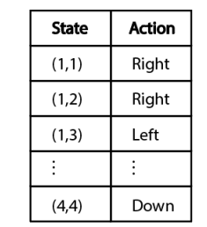
Take a policy as input and evaluate V(s) using this policy
Assume input policy is
Find V(s) for this input policy using TD-learning

Slide 15
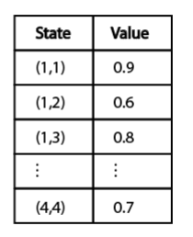

Initialize the value of all states to some random values.
Step 1: Current state s = (1,1) a = right as per the input policy
next state s’ = (1,2)
update V((1,1)) using TD –learning update rule as
Assume γ = 1 and α = 0.1

Slide 16
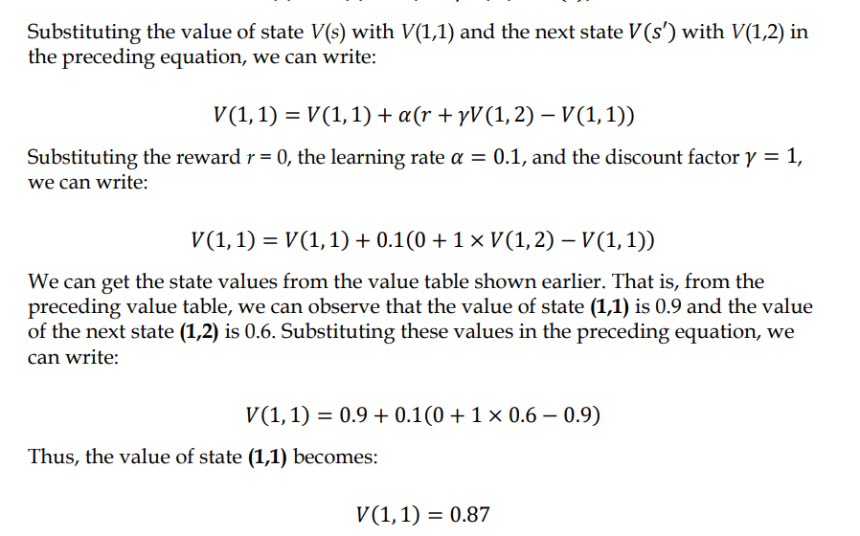

Slide 17
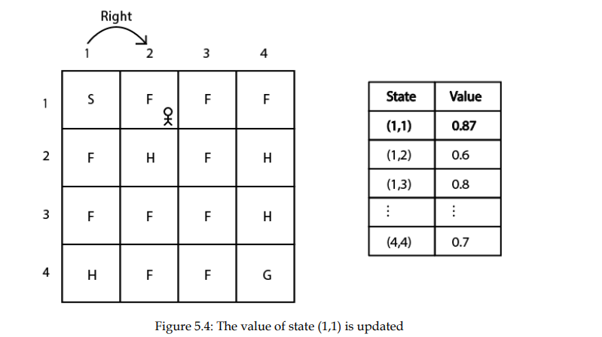
Updated value table after step1 is

Slide 18

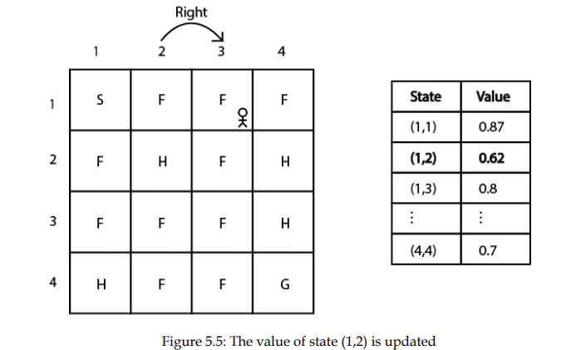


Step 2 : s = (1,2) a = right s’ = (1,3) r = 0 α = 0.1 and γ = 1
current value of V((1,2)) = 0.6
update V((1,2)) using TD-learning
Value table after step 2 is

Slide 19

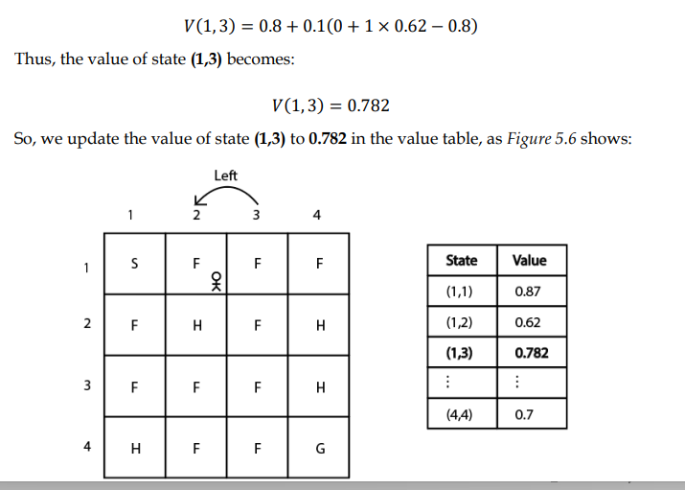
Step 3 : s = (1,3) a = left r = 0 s’ = (1,2) current V(1,3) = 0.8 and V(1,2) = 0.62
Update V(1,3)

Slide 20
Thus, in this way, we compute the value of every state using the given policy.
However, computing the value of the state just for one episode will not be accurate.
So, we repeat these steps for several episodes and compute the accurate estimates of the state value (the value function).

Slide 21
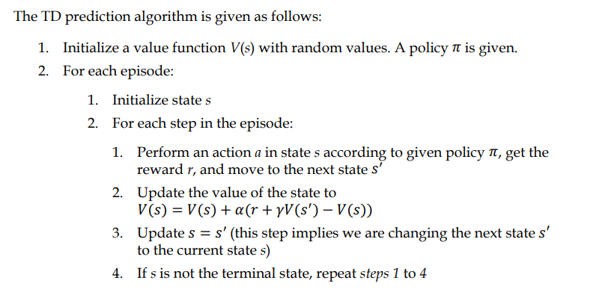
TD-Prediction Algorithm

Slide 22
Using TD-Prediction in FZLE
For an input random policy π, predict the value of the states V(s) using TD prediction
import gymnasium as gym
import pandas as pd
#create the envt
env = gym.make("FrozenLake-v1", render_mode = "human")
env.reset()
env.render()

Slide 23
#define a random input policy
def random_policy():
return env.action_space.sample()
#initialize the value of all states to zeros
V = {}
for s in range(env.observation_space.n):
V[s] = 0.0
#initialize the parameters
alpha = 0.85
gamma = 0.90
num_eps = 50
num_steps = 10

Slide 24
#generating episodes
for i in range(num_eps):
s = env.reset()
s = s[0]
for t in range(num_steps):
a = random_policy()
s_, r, done, _, _ = env.step(a)
#use TD-update rule
V[s] += alpha * (r + gamma * V[s_] - V[s])
s = s_
if done:
break

Slide 25
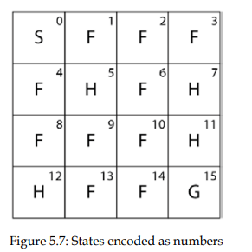
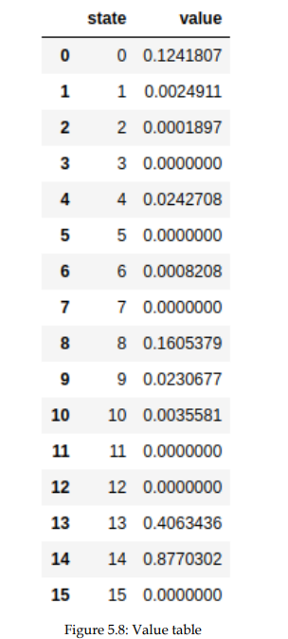
#convert the dictionary to a data frame
df = pd.DataFrame(list(V.items()), columns = ['state', 'value'])
print(df)
Output :
Value of state 14 is
maximum
Value of all terminal states(hole
state and goal state) are
zeroes
Note that since we have initialized a random policy,
We might get varying results every time we
run the previous code

Slide 26
TD-Control
Start with a random policy and find an optimal policy iteratively
Types – on-policy and off-policy TD-control
On-policy control :
the agent behaves using one policy and tries to improve the same policy.
That is, in the on-policy method, we generate episodes using one policy and improve the same policy iteratively to find the optimal policy
Off-policy control:
the agent behaves using one policy and tries to improve a different policy.
That is, in the off-policy method, we generate episodes using one policy and we try to improve a different policy iteratively to find the optimal policy.

Slide 27


On-policy TD-Control - SARSA
SARSA – state-action-reward-state-action
in TD control our goal is to find the optimal policy.
how can we extract a policy?
We can extract the policy from the Q function.
once we have the Q function then we can extract policy by selecting the action in each state that has the maximum Q value.
how can we compute the Q function in TD learning?
Recall, in TD learning, the value function is computed as:
We can just rewrite this update rule in terms of the Q function as:

Slide 28
we compute the Q function using the preceding TD learning update rule, and then we extract a policy from them.
the preceding update rule is also known as the SARSA update rule
In the prediction method, we were given a policy as input, so we acted in the environment using that policy and computed the value function.
But here, we don't have a policy as input. So how can we act in the environment?

Slide 29
So, first we initialize the Q function with random values or with zeros.
Then we extract a policy from this randomly initialized Q function and act in the environment.
Our initial policy will definitely not be optimal as it is extracted from the randomly initialized Q function, but on every episode, we will update the Q function (Q values).
So, on every episode, we can use the updated Q function to extract a new policy.
Thus, we will obtain the optimal policy after a series of episodes.

Slide 30
One important point we need to note is that in the SARSA method, instead of making our policy act greedily, we use the epsilon-greedy policy.
In a greedy policy, we always select the action that has the maximum Q value. But, with the epsilon-greedy policy we select a random action with probability epsilon, and we select the best action (the action with the maximum Q value) with probability of 1-epsilon.

Slide 31
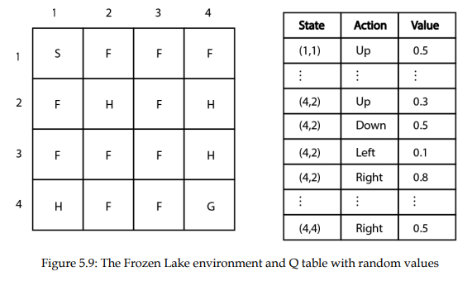
SARSA in the FZLE
Initialize the Q function with random values

Slide 32
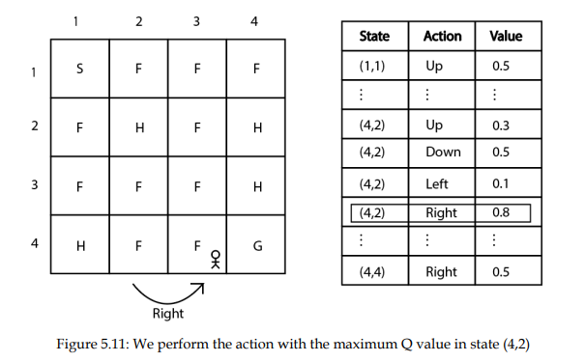
Assume we are in state (4,2)
Select an action using epsilon greedy policy.
With probability epsilon, we select a random action and with probability 1-epsilon we select the best action (the action that has the maximum Q value).
Suppose we use a probability 1-epsilon and select the best action.
So, in state (4,2), we move right as it has the highest Q value compared to the other actions.
so, we perform the right action in state (4,2) and move to the next state (4,3) as shown in the fig

Slide 33
we moved right in state (4,2) to the next state (4,3) and received a reward r of 0, next state s’ = (4,3)
Assume learning rate 𝛼 at 0.1, and the discount factor 𝛾 at 1
Update the Q((4,2), right), using SARSA update rule
Substituting 𝛼 and 𝛾
Substituting Q((4,2), right) = 0.8, from the previous Q –table :

Slide 34
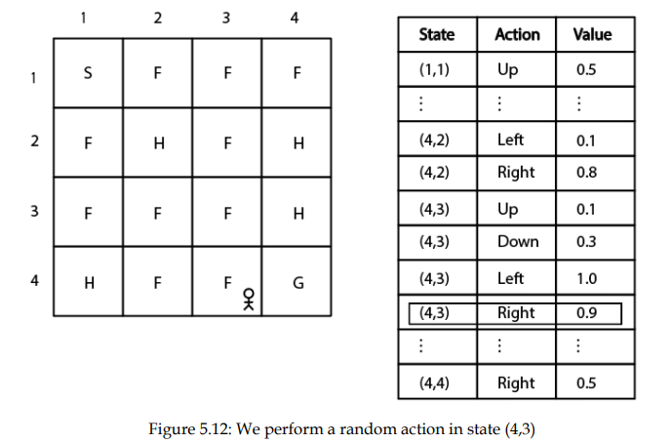
what about the term 𝑄((4, 3), 𝑎′ )? – Q-value of the next state-action pair?
We need to choose the action a’ in the next state using epsilon-greedy policy
we select a random action with a probability of epsilon, or we select the best action that has the maximum Q value with a probability of 1-epsilon.
Suppose we use probability epsilon and select the random action. In state (4,3), we select the right action randomly, as Figure 5.12 shows.
As you can see, although the right action does not have the maximum Q value, we selected it randomly with probability epsilon

Slide 35


Use the update rule now :
substituting the value of Q((4,3), right) with 0.9
Hence the updated Q-value is
in this way, we update the Q function by updating the Q value of the state-action pair in each step of the episode.
After completing an episode, we extract a new policy from the updated Q function and uses this new policy to act in the environment. (Remember that our policy is always an epsilon-greedy policy).
We repeat this steps for several episodes to find the optimal policy.

Slide 36
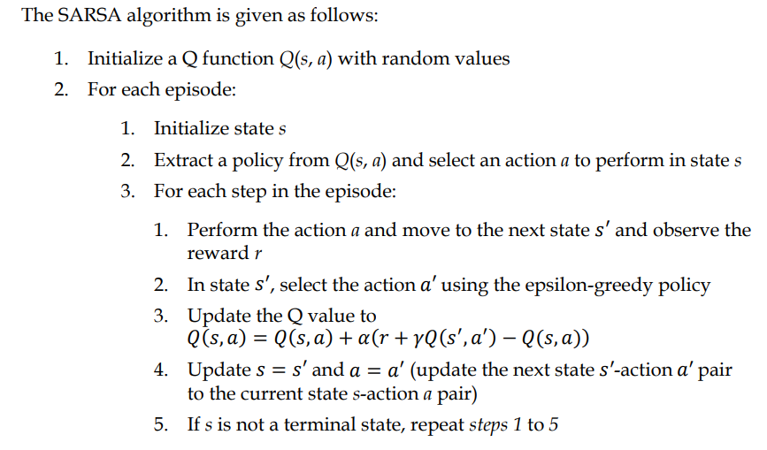
SARSA algorithm

Slide 37
Implement SARSA in FZLE
Find an optimal policy for the FZLE using SARSA
#import libraries
import gymnasium as gym
import random
#create the envt
env = gym.make("FrozenLake-v1", render_mode = "human")
env.reset()
env.render()

Slide 38
#define a dictionary for the Q table. Initialize the Q value of all (s,a) #pairs to 0.0
Q = {}
for s in range(env.observation_space.n):
for a in range(env.action_space.n):
Q[(s,a)] = 0.0

Slide 39
#define the epsilon-greedy policy. We generate a random number #from the uniform distribution of 0 to 1.
#If the random number is less than epsilon, we select a random #action, else we select the best action.
def epsilon_greedy(state, epsilon):
if random.uniform(0,1) < epsilon:
return env.action_space.sample()
else:
return max(list(range(env.action_space.n)), key = lambda x :
Q[(state,x)])

Slide 40
# initialize alpha, gamma and epsilon
alpha = 0.85
gamma = 0.90
epsilon = 0.8
#set the no. of episodes and the no. of steps in each episode
num_eps = 500
num_steps = 100

Slide 41
#compute the policy for each episode
for i in range(num_eps):
s = env.reset()
s = s[0]
a = epsilon_greedy(s,epsilon)
for t in range(num_steps):
s_, r, done, _, _ = env.step(a)
a_ = epsilon_greedy(s_, epsilon)
predict = Q[(s,a)]
target = r + gamma * Q[(s_, a_)]
Q[(s,a)] = Q[(s,a)] + alpha * (target - predict)
s = s_
a = a_
if done:
break

Slide 42
Convert the Q-table into a frame and print
Note that on every iteration we update the Q function.
After all the iterations, we will have the optimal Q function.
Once we have the optimal Q function then we can extract the optimal policy by selecting the action that has the maximum Q value in each state.

Slide 43
Off-policy TD control – Q-learning
Q learning is an off-policy algorithm,
it uses two different policies, one policy for behaving in the environment (selecting an action in the environment) and the other for finding the optimal policy.
In SARSA, we use epsilon-greedy policy to choose and action in the current state s, then used the SARSA update rule for Q(s,a)
Also in the next state-action pair Q(s’,a’), we used the same epsilon greedy policy to select an action in s’ and then updated Q(s’,a’)

Slide 44
unlike SARSA, in Q learning, we use two different policies.
One is the epsilon-greedy policy and the other is a greedy policy.
To select an action in the environment we use an epsilon-greedy policy, but while updating the Q value of the next state-action pair Q(s’, a’)we use a greedy policy

Slide 45


we select action a in state s using the epsilon-greedy policy and move to the next state 𝑠′ and update the Q value using the update rule shown below:
To find Q(s’,a’) we select and action using the greedy-policy, the policy that has the maximum Q-value in s’
So the update rule of Q learning is given as:

Slide 46
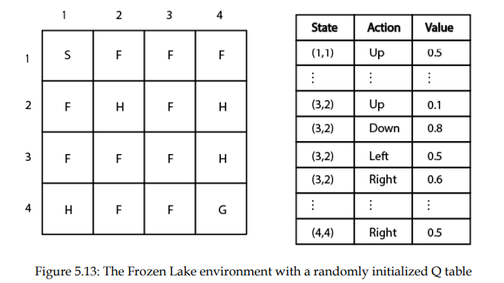
Q-learning in FZLE
Initialise the Q-table to random values

Slide 47
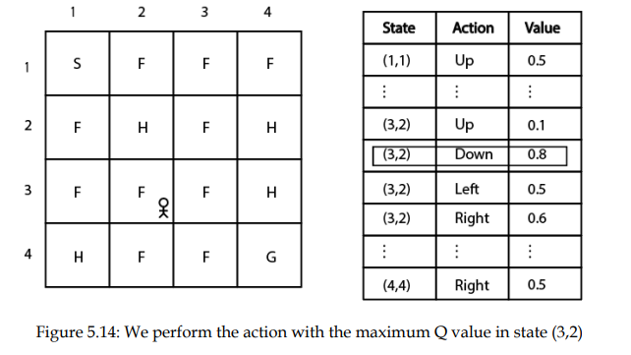
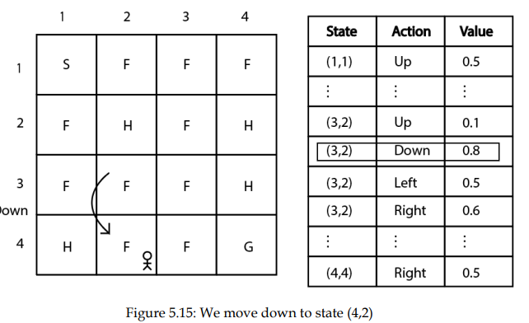
Assume we are in state (3,2)
Select an action using epsilon – greedy policy. Assume with prob of 1-epsilon we choose the best action ‘down’
we perform the down action in state (3,2) and move to the next state (4,2), with r =0. Assume e learning rate 𝛼𝛼 as 0.1, and the discount factor 𝛾𝛾 as 1

Slide 48
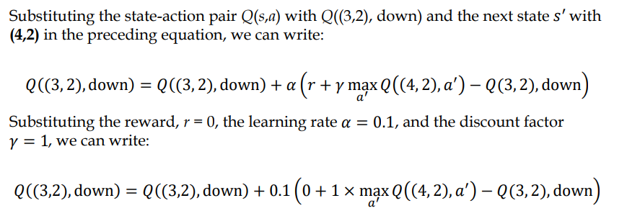
Update Q((3,2),down) using Q-learning update rule as

Slide 49
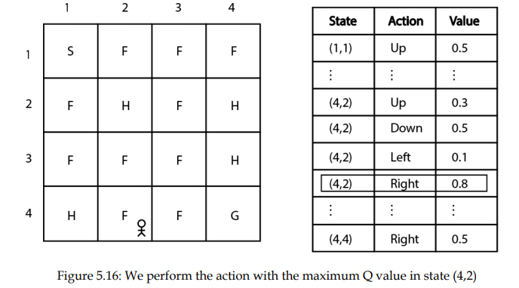
Use greedy-policy to select a’ in s’.
the right action has the maximum Q value in state (4,2).
So, we select the right action and update the Q value of the next state-action pair:

Slide 50
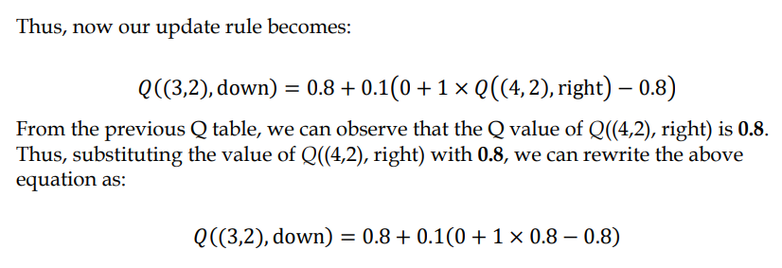
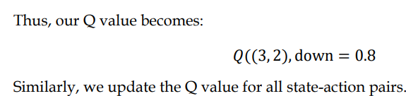

Slide 51
in this way, we update the Q function by updating the Q value of the state-action pair in each step of the episode.
We will extract a new policy from the updated Q function on every step of the episode and uses this new policy.
Remember that we select an action in the environment using epsilon-greedy policy but while updating Q value of the next state-action pair we use the greedy policy.
After several episodes, we will have the optimal Q function

Slide 52
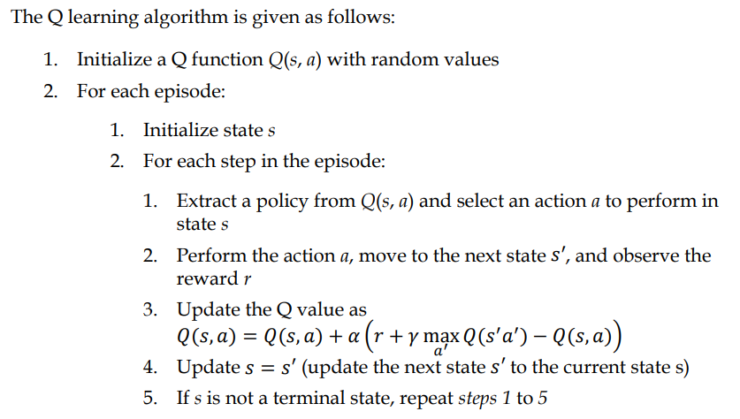
Q-learning algorithm

Slide 53
Implement Q-learning in FZLE
import gymnasium as gym
import numpy as np
import random
env = gym.make("FrozenLake-v1", render_mode = "human")
Q = {}
for s in range(env.observation_space.n):
for a in range(env.action_space.n):
Q[(s,a)] = 0.0

Slide 54
def epsilon_greedy(state, epsilon):
if random.uniform(0,1) < epsilon:
return env.action_space.sample()
else:
return max(list(range(env.action_space.n)), key = lambda x: Q[(state,x)])
alpha = 0.85
gamma = 0.90
epsilon = 0.8
num_eps = 500
num_steps = 100

Slide 55
for i in range(num_eps):
s = env.reset()
s = s[0]
for t in range(num_steps):
a = epsilon_greedy(s,epsilon)
s_, r, done, _, _ = env.step(a)
a_ = np.argmax([Q[(s,a)] for a in range(env.action_space.n)])
Q[(s,a)] += alpha * ( r + gamma * Q[(s_,a_)] - Q[(s,a)])
s = s_
if done:
break

Slide 56


Differences between SARSA and Q-learning
S.No | SARSA | Q-learning
1 | SARSA is an on-policy algorithm | Q learning is an off-policy algorithm
2 | we use a single epsilon-greedy policy for selecting an action in the environment and also to compute the Q value of the next state-action pair | we use an epsilon-greedy policy for selecting an action in the environment, but to compute the Q value of next stateaction pair we use a greedy policy
3 | The SARSA update rule is : | The Q-learning update rule is :

Slide 57
Classical RL algorithms
To learn an optimal policy :
DP – value and policy iteration, MC and TD
Comparison of DP, MC and TD methods:
Dynamic programming (DP), that is, the value and policy iteration methods,
is a model-based method, meaning that we compute the optimal policy using the model dynamics of the environment.
We cannot apply the DP method when we don't have the model dynamics of the environment.
MC
is a model-free method, meaning that we compute the optimal policy without using the model dynamics of the environment.
But one problem we face with the MC method is that it is applicable only to episodic tasks and not to continuous tasks.
TD :
a model-free method.
TD learning takes advantage of both DP by bootstrapping and the MC method by being model free.

